Slide 1

EE150 Signals and Systems
Tutorial 10
Guorui Cui
Shanghaitech University
May 2024
Tutorial 10
EE 150
May 2024

Slide 2
Outline
Outline
1.Discrete-time Fourier Transform
2.DTFT on periodic signals
Tutorial 10
EE 150
May 2024

Slide 3
01
Discrete-time Fourier Transform
1.Discrete-time Fourier Transform
Tutorial 10
EE 150
May 2024

Slide 4
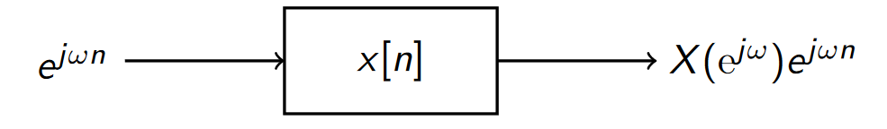
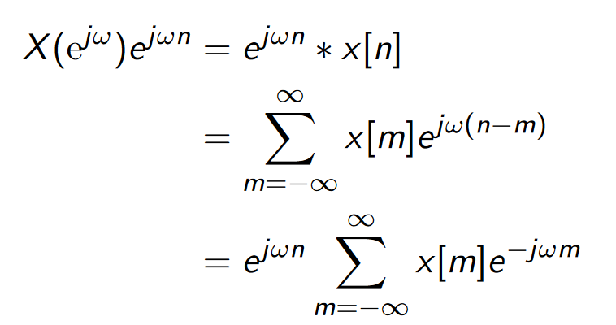

01
Discrete-time Fourier Transform
Eigenfunction
Tutorial 10
EE 150
May 2024

Slide 5
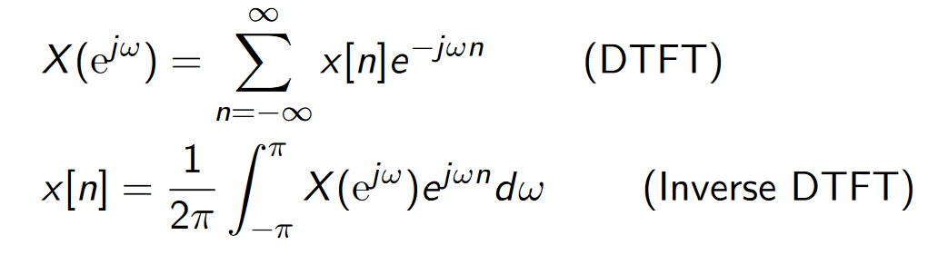
01
Discrete-time Fourier Transform
Continuous
Discrete
Tutorial 10
EE 150
May 2024

Slide 6
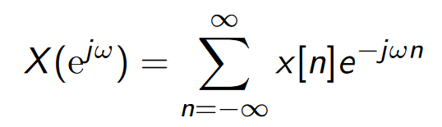
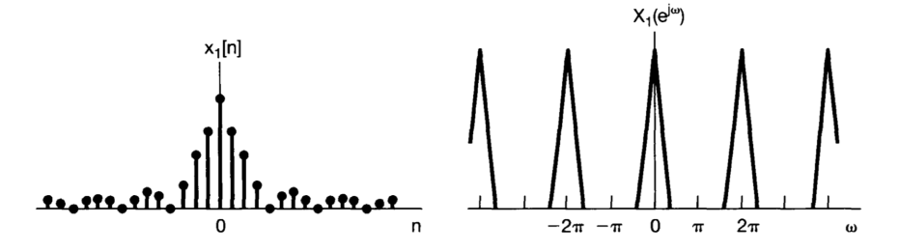
01
Discrete-time Fourier Transform
Periodic
Tutorial 10
EE 150
May 2024

Slide 7
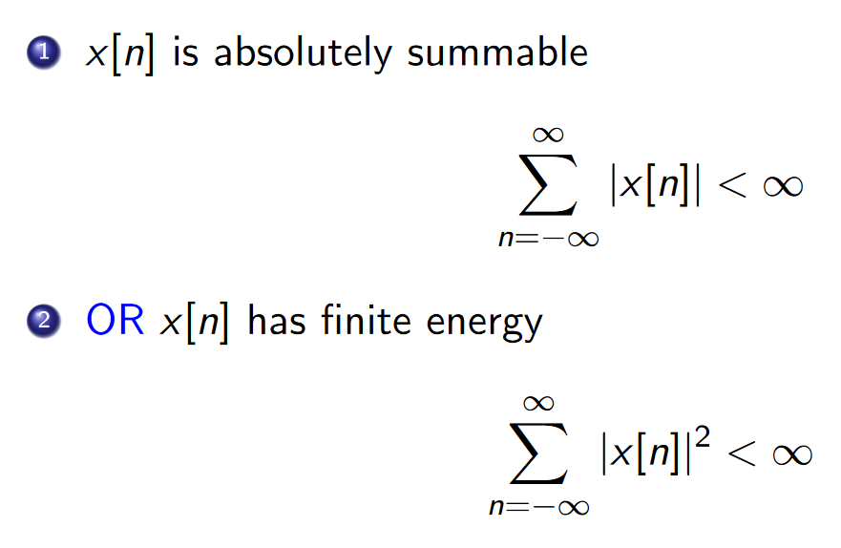
01
Discrete-time Fourier Transform
Fourier transform can be applied iff:
Tutorial 10
EE 150
May 2024

Slide 8
02
DTFT on periodic signals
2.DTFT on periodic signals
Tutorial 10
EE 150
May 2024

Slide 9
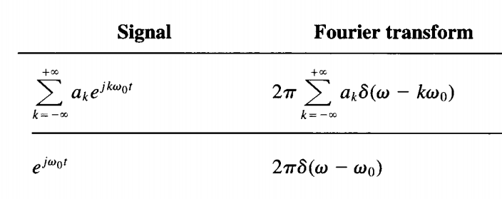
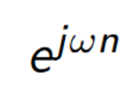
02
DTFT on periodic signals
Impulse at x=ω
Also impulse at x=ω
Tutorial 10
EE 150
May 2024

Slide 10
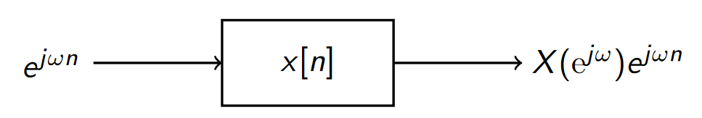
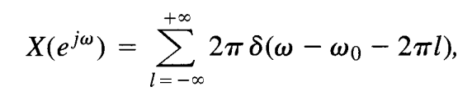
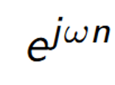
02
DTFT on periodic signals
Periodic!
Tutorial 10
EE 150
May 2024

Slide 11
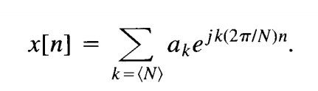
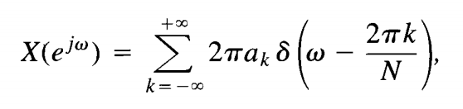
02
DTFT on periodic signals
For any periodic x[n]:
Tutorial 10
EE 150
May 2024

Slide 12
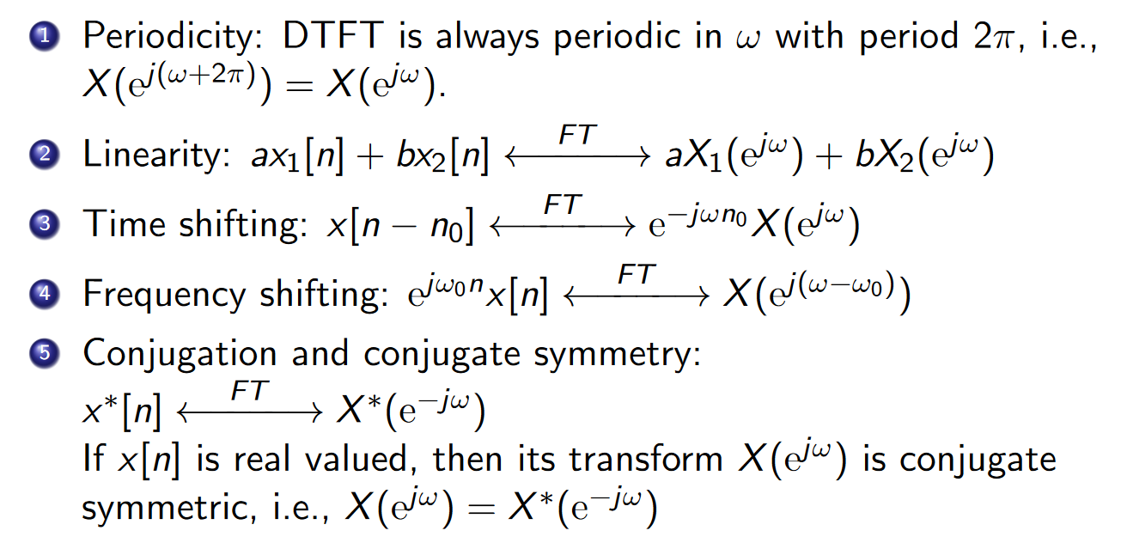
02
DTFT on periodic signals
Properties
Tutorial 10
EE 150
May 2024

Slide 13
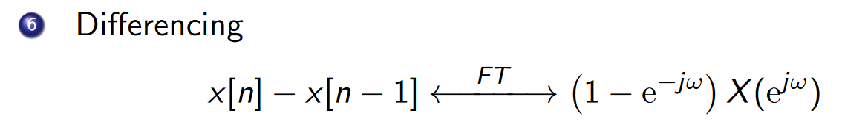
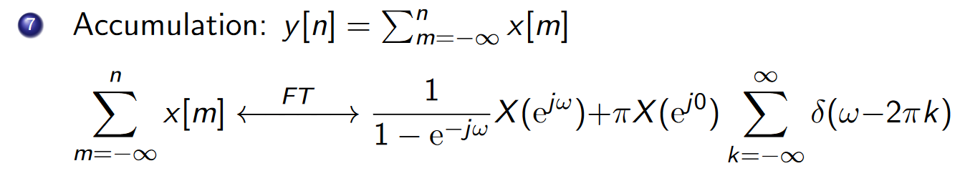
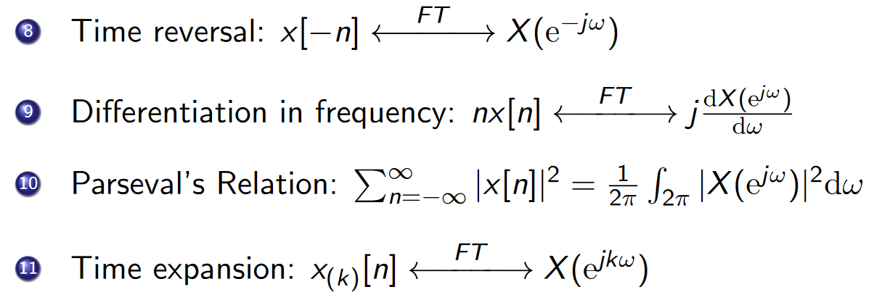
02
DTFT on periodic signals
Tutorial 10
EE 150
May 2024

Slide 14




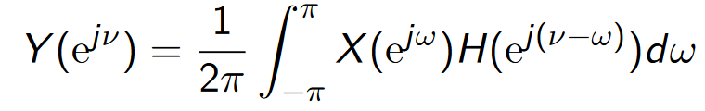
02
DTFT on periodic signals
Tutorial 10
EE 150
May 2024

Slide 15

02
DTFT on periodic signals
Ex1.
Tutorial 10
EE 150
May 2024

Slide 16
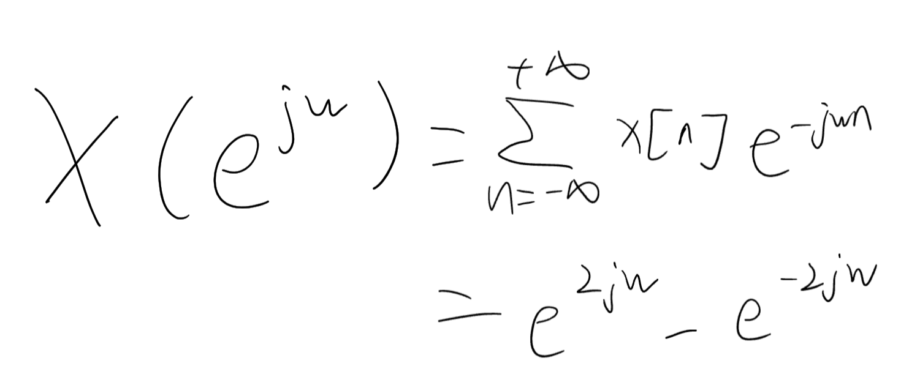
02
DTFT on periodic signals
Ex1.
Tutorial 10
EE 150
May 2024

Slide 17

02
DTFT on periodic signals
Ex2.
Tutorial 10
EE 150
May 2024

Slide 18
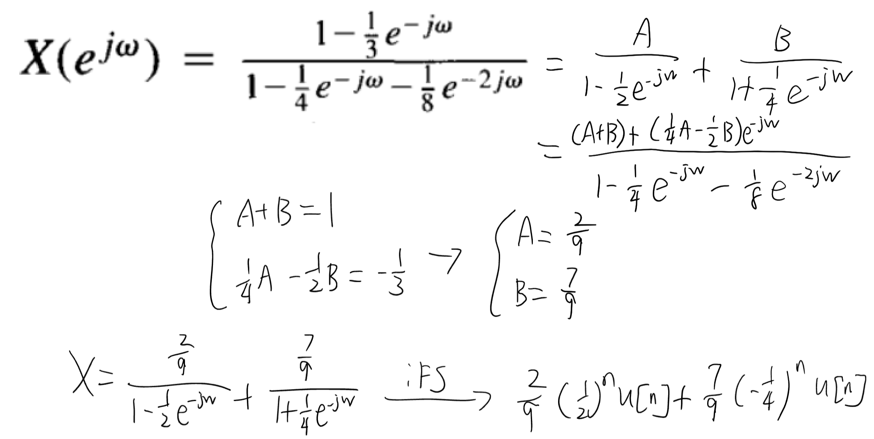
02
DTFT on periodic signals
Ex2.
Tutorial 10
EE 150
May 2024

Slide 19
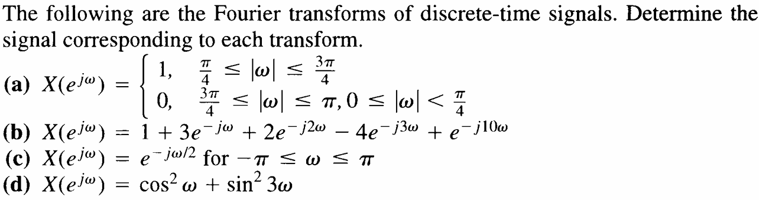
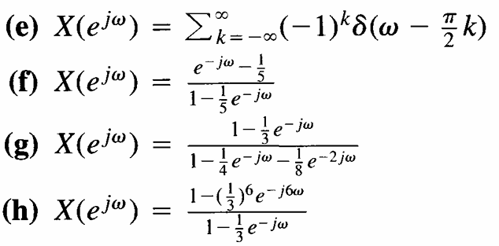
02
DTFT on periodic signals
Ex3.
Tutorial 10
EE 150
May 2024

Slide 20
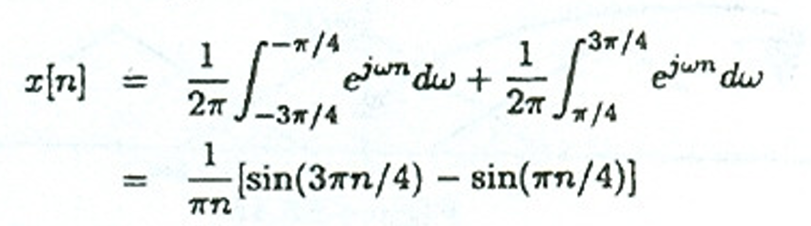
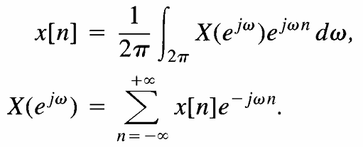
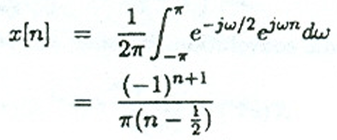
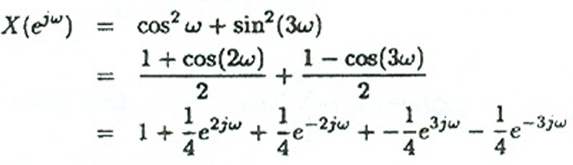
02
DTFT on periodic signals
Ex3.
(a)
(b)
(c)
(d)
Tutorial 10
EE 150
May 2024

Slide 21

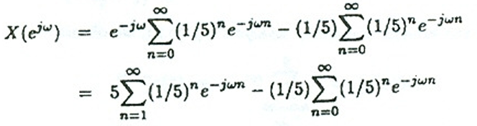



02
DTFT on periodic signals
Ex3.
(e)
(f)
(g)
(h)
Tutorial 10
EE 150
May 2024

